Slide 1
ScheduleSource
ISU Dining Scheduling Program
Notes:
What is it? New to everyone
Who all is currently using it?
What do I need to know about it?
How do I check my schedule?
How do I change a schedule for a class change?
Who do I contact?
How do I contact a substitute?

Slide 2
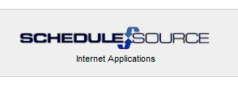
What is ScheduleSource?
ScheduleSource is an online scheduling system that ISU Dining and ISU Catering uses.
Student schedules are more accessible than ever.

Slide 3
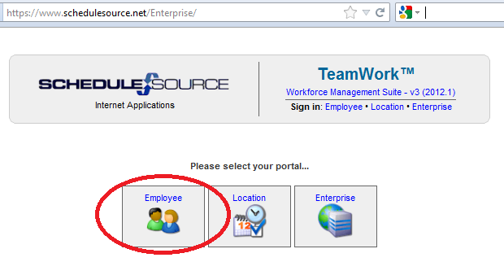
How to Log In
Go to: https://www.schedulesource.net/Enterprise/
Click on: Employee
Use https://www.schedulesource.net/Enterprise/Mobile/
if on a web- enabled device

Slide 4
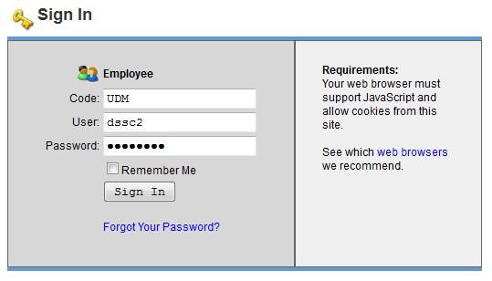
Credentials
Entering your LOCATION CODE
*It is extremely important that you enter the code for the facility in which you work or have been hired, exactly as it appears below (MAKE NOTE OF YOUR LOCATION):
Bakery Friley Roast
Cafes Hawthorn Seasons
Clydes ISU Catering SSM
Conversations KS Comm Storms
ESM MU Food Court UDM
Food Stores MU Market WSM
Food Truck Plato
*Union Drive Marketplace, Memorial Union, East Side Market, South Side Market & West Side Market
are all abbreviated

Slide 5

Credentials
2. User: your NetID
This is the first part of ISU email address
Prior to the @ sign
For example: dssc2@iastate.edu – “dssc2” would be the User
3. Password: the password you created when you applied online
IF you’re having troubles logging in, contact the DSSO.
MORE THAN 8 FAILED ATTEMPTS
WILL LOCK YOU OUT!

Slide 6
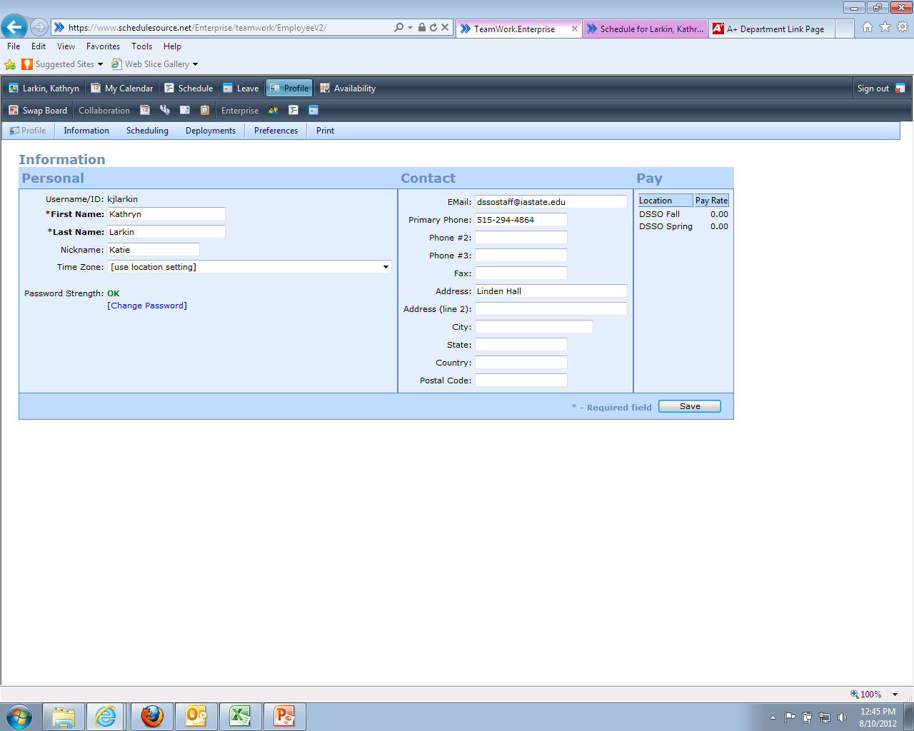
PROFILE
Iowa State email address and current phone numbers are required at all times.
Change your password here!
Update your information on a regular basis!
All phones need to have the voice mail box set up and able to receive phone messages (empty any full boxes)!

Slide 7
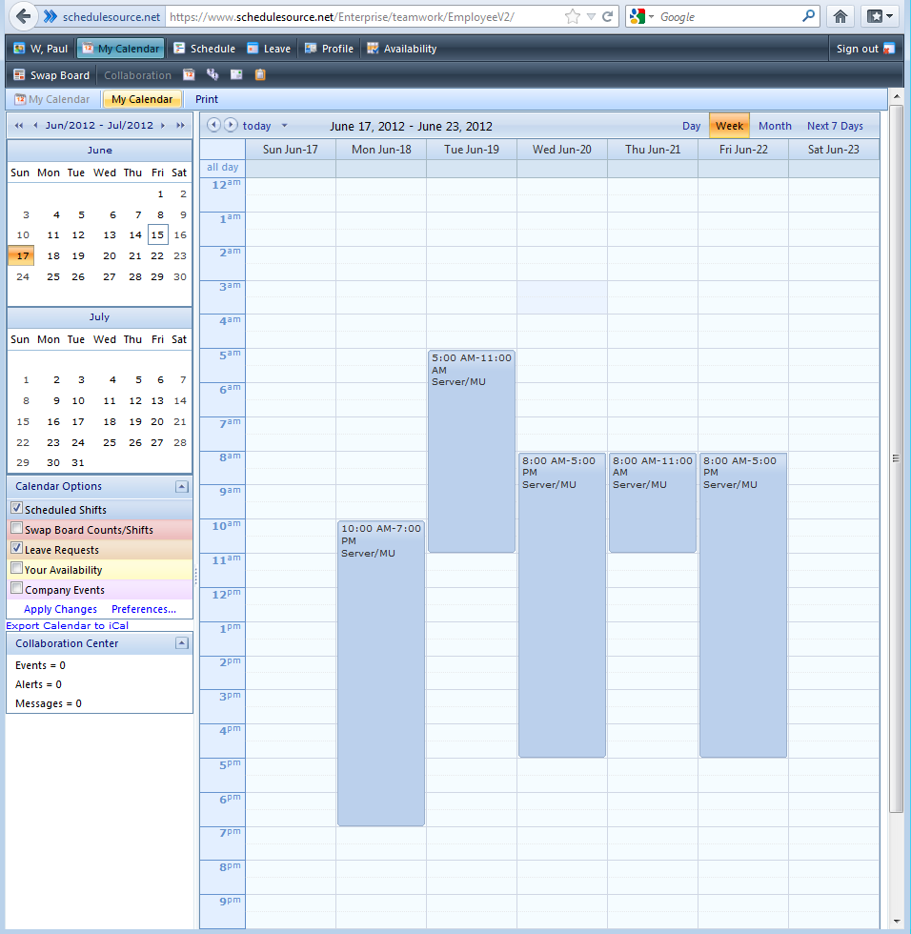
Your Calendar
When you first log in, all of your shifts are available at a glance!
REMEMBER, your schedule reads SUNDAY through SATURDAY!

Slide 8
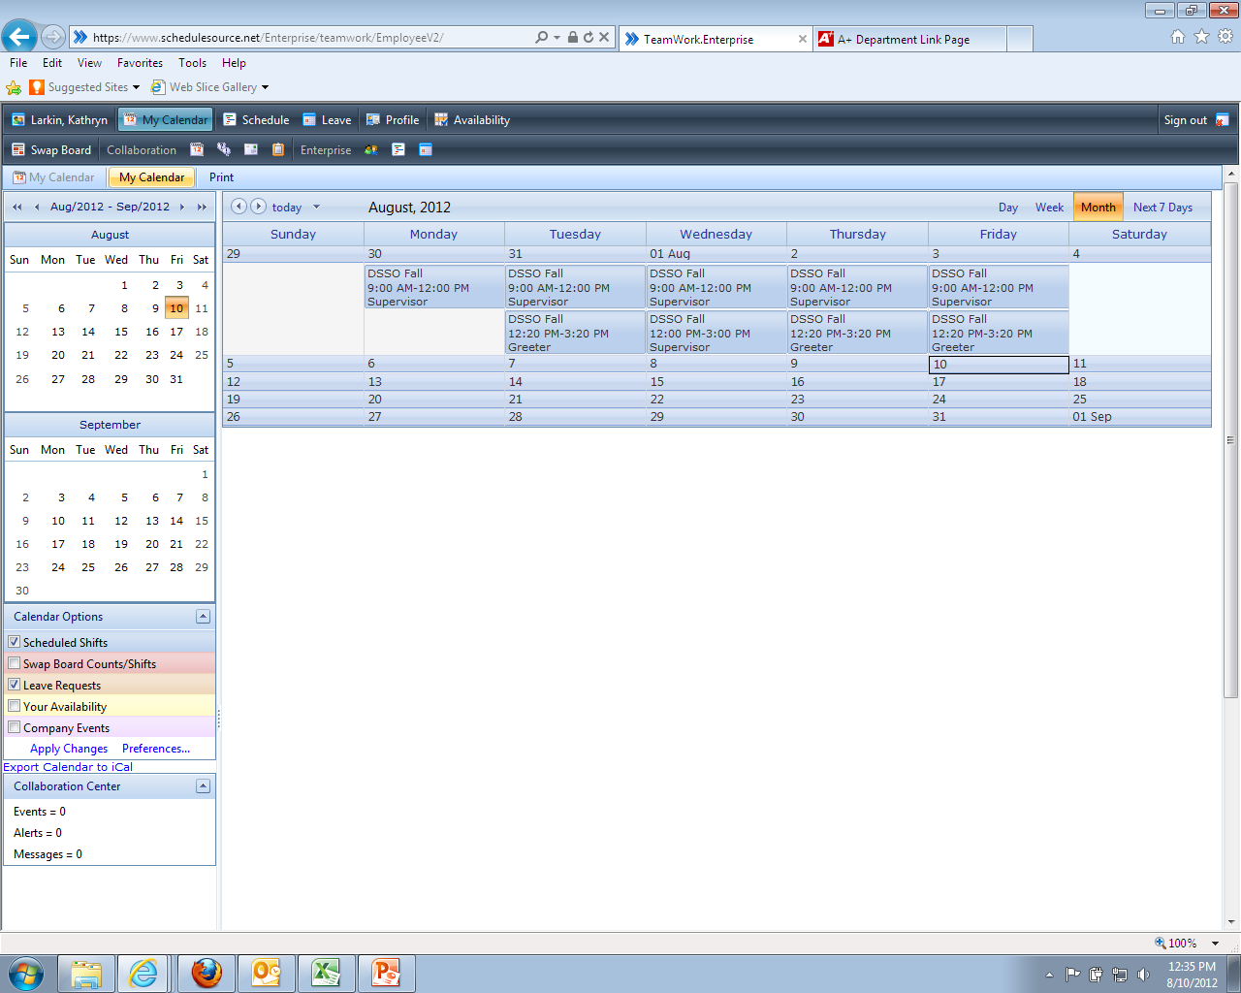
View Options
Make sure to set preferences to the “month view”

Slide 9


Things to Remember…
Remember your password and keep it in a safe place
If you fail to log in more than 8 times, ask DSSO for assistance – avoid locking everyone out in your IP Address!
You must keep your information (ISU email address & phone number) up to date & activate your voice mail boxes. THIS INFORMATION IS REQUIRED!
Permanent schedule change requests must go through the DSSO (such as class changes)
Schedule Source can be accessed via phone, work computer, home computer, any internet means
Your schedule may be adjusted to best suit the needs of your facility
You will be notified via email of schedule changes, so be sure to check your schedule and ISU email often.

Slide 10

How to Put a Shift on the
Swap Board
Shift

Slide 11
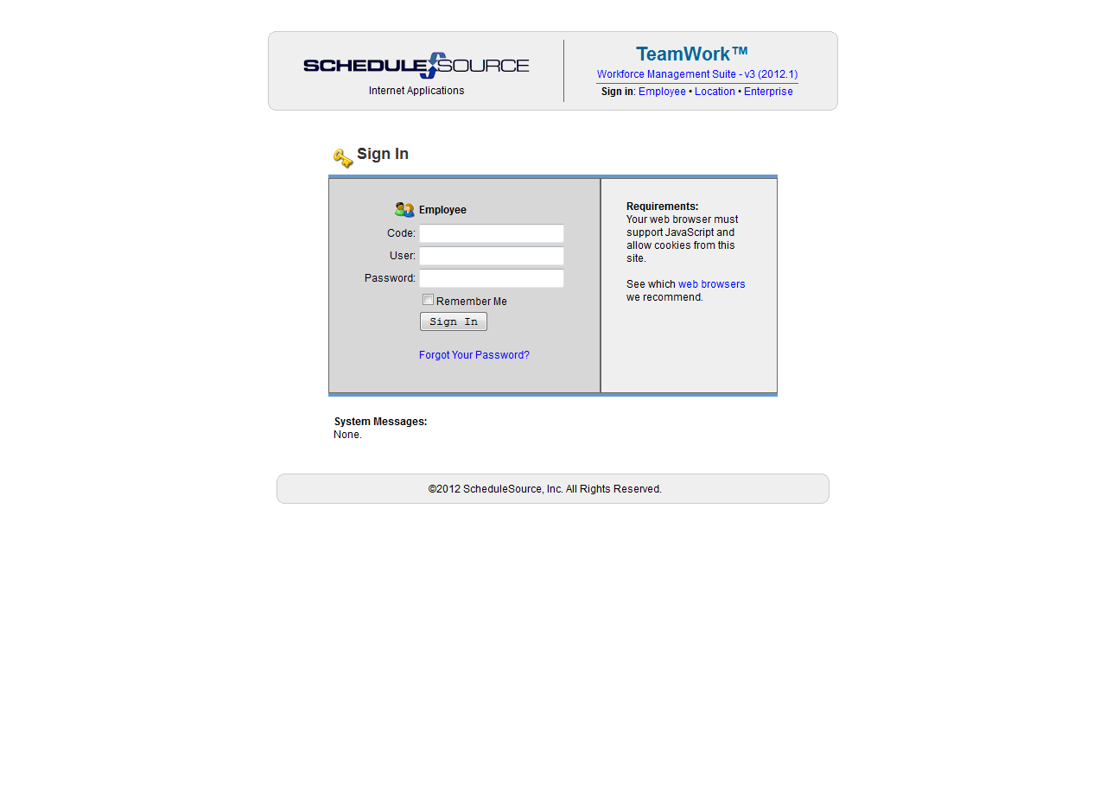
Log on to Your Personal Portal
Code: The location where you work
User: Your Net ID
Password: Password you created when you applied online
The Swap Board is a tool to assist you in finding a substitute to work a shift for you OR to pick up and work a shift for someone else.

Slide 12
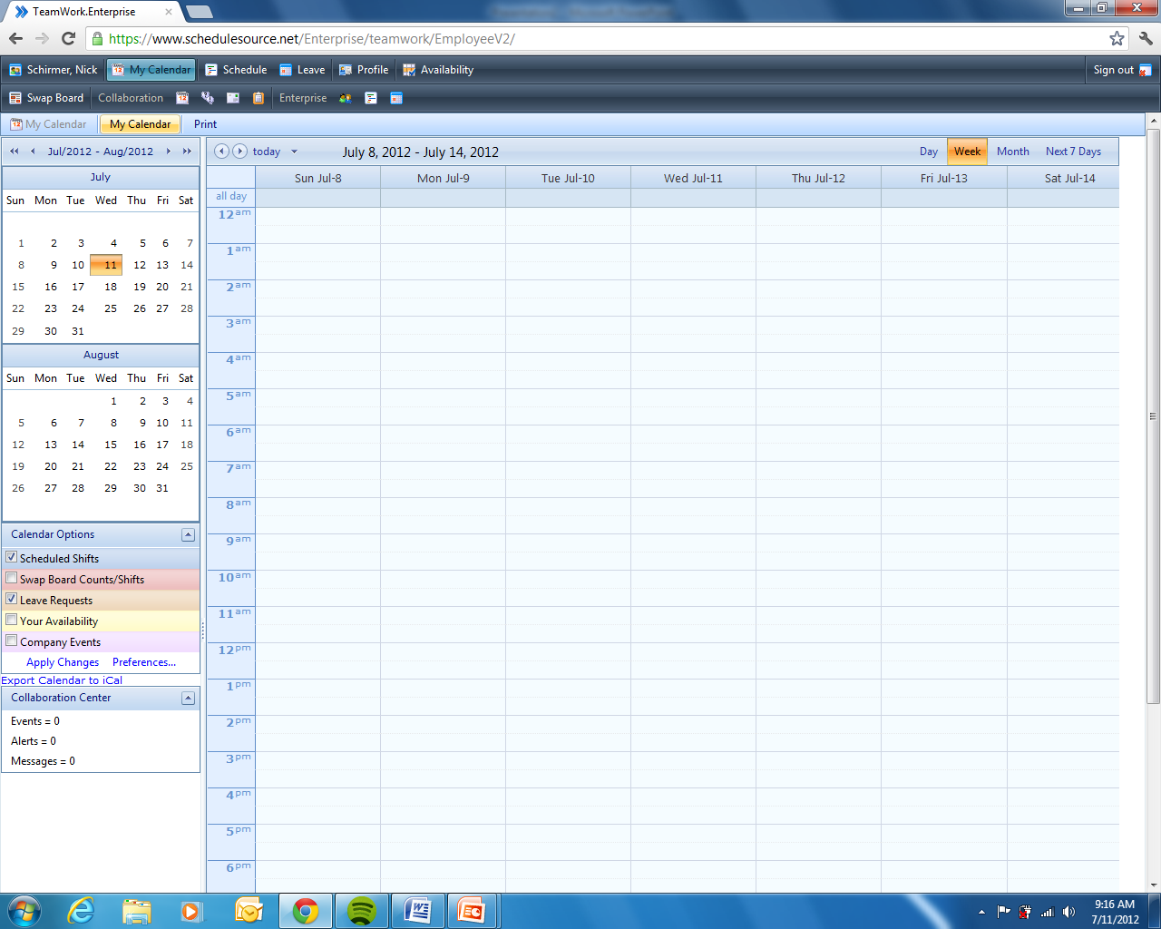
Click on the Swap Board Tab
Once you have logged in you will be taken to your calendar. The swap board tab is located in the top left hand corner of the screen. Click on it to bring up the swap board.

Slide 13
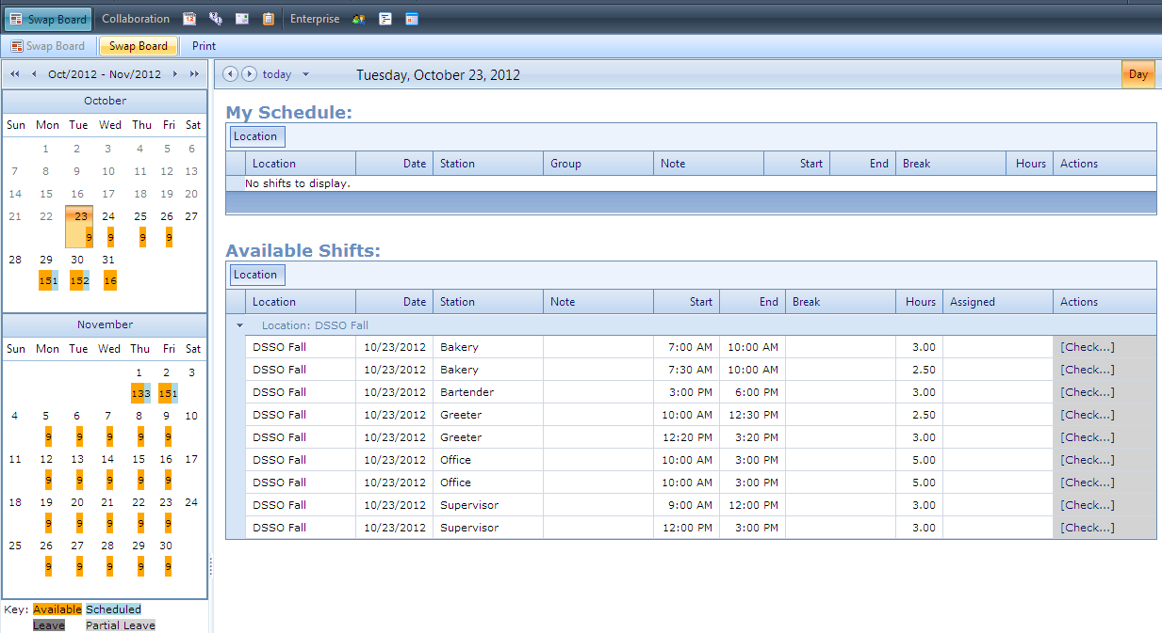
Viewing the Calendar
To see the available shifts on a certain date, click on the date you wish to view.
Orange shifts below show number of available shifts to pick up
Blue shifts below show your scheduled number of shifts

Slide 14
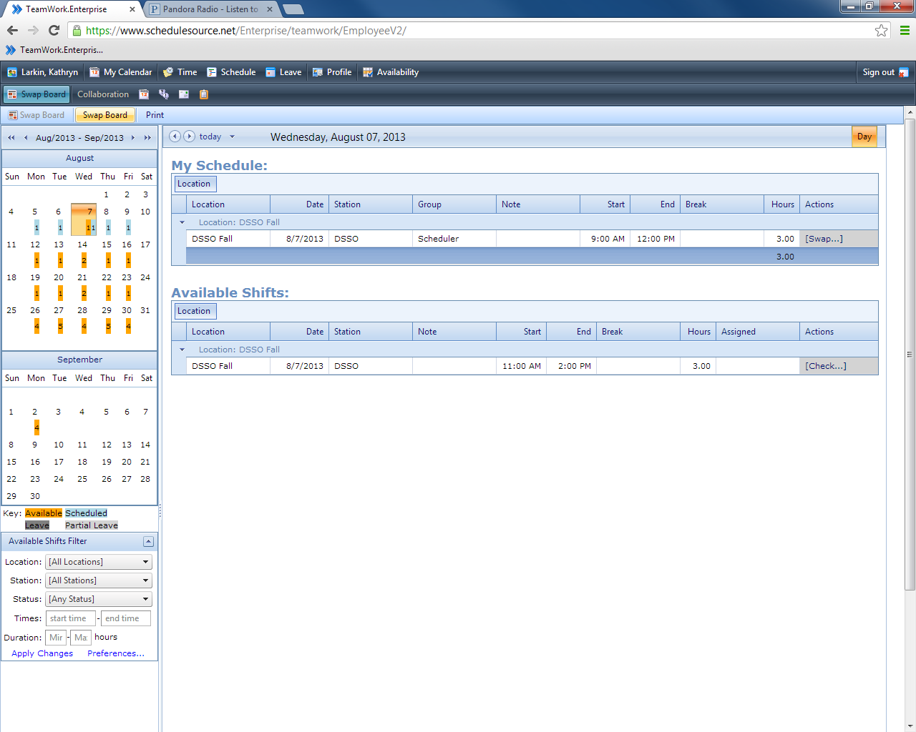
Add a Shift to the Swap Board
This is the swap board page. By selecting a date from the calendar on the left hand side, you can bring up your scheduled shifts along with shifts that are available to pick up that day.

Slide 15
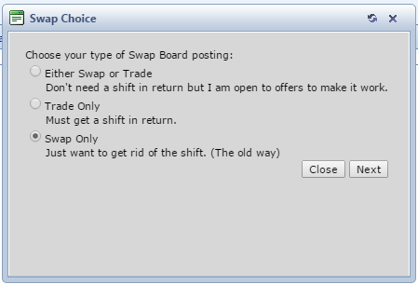
To place a shift on the swap board click on “Swap” next to the shift.
Once you click on the swap button a gray box will appear in the middle of the screen. Choose “Swap Only.”
1.
2.

Slide 16
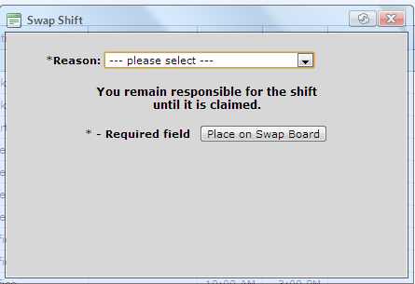

3. Select a reason from the drop down list.
4. Click on the “Place on Swap Board” button.
3.
4.

Slide 17
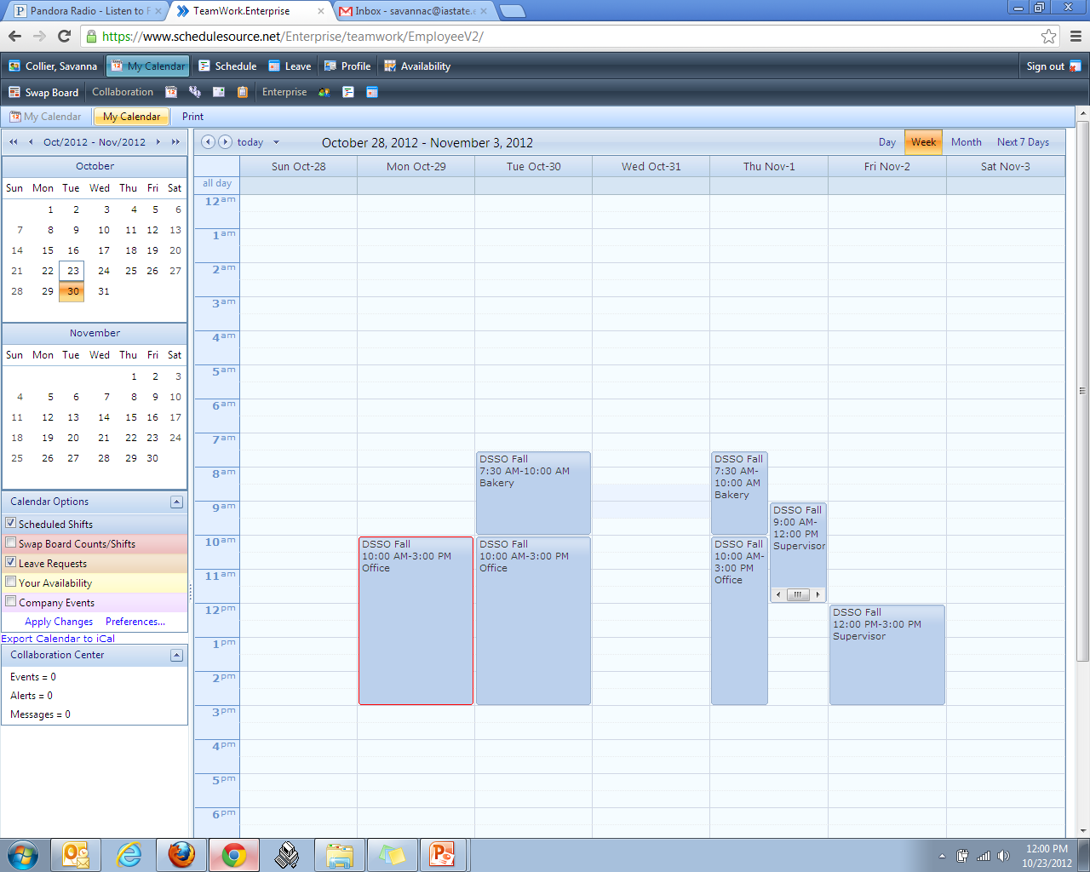
Once You’ve Put it on the Swap Board
A red box will show up around that shift on your schedule
Once someone picks up your shift, it will disappear completely from your schedule
If the shift still appears on your schedule, you must work it, even if your shift has the red box surrounding it

Slide 18

How to pick up a shift
Shift

Slide 19
Picking up a Shift from the
Swap Board
All of the available shifts for you to pick up are listed under “Available Shifts”.
To pick up a shift click on the “Check” link.

Slide 20
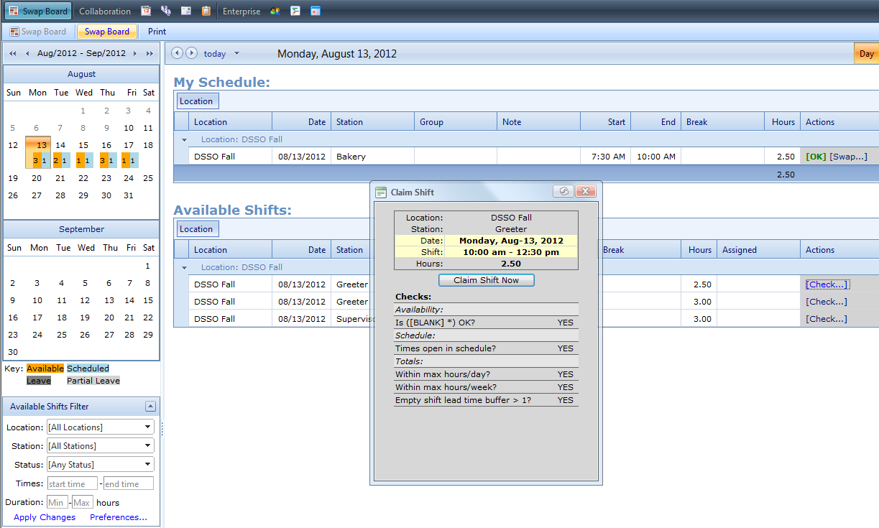
When you click on “check”, a box will appear on your screen.
If you do not have any conflicts you will be able to select the “Claim Shift Now” button.
ISU policy is that you may only work 20 hours, Sunday – Saturday, while classes are in session during Fall and Spring semesters.

Slide 21
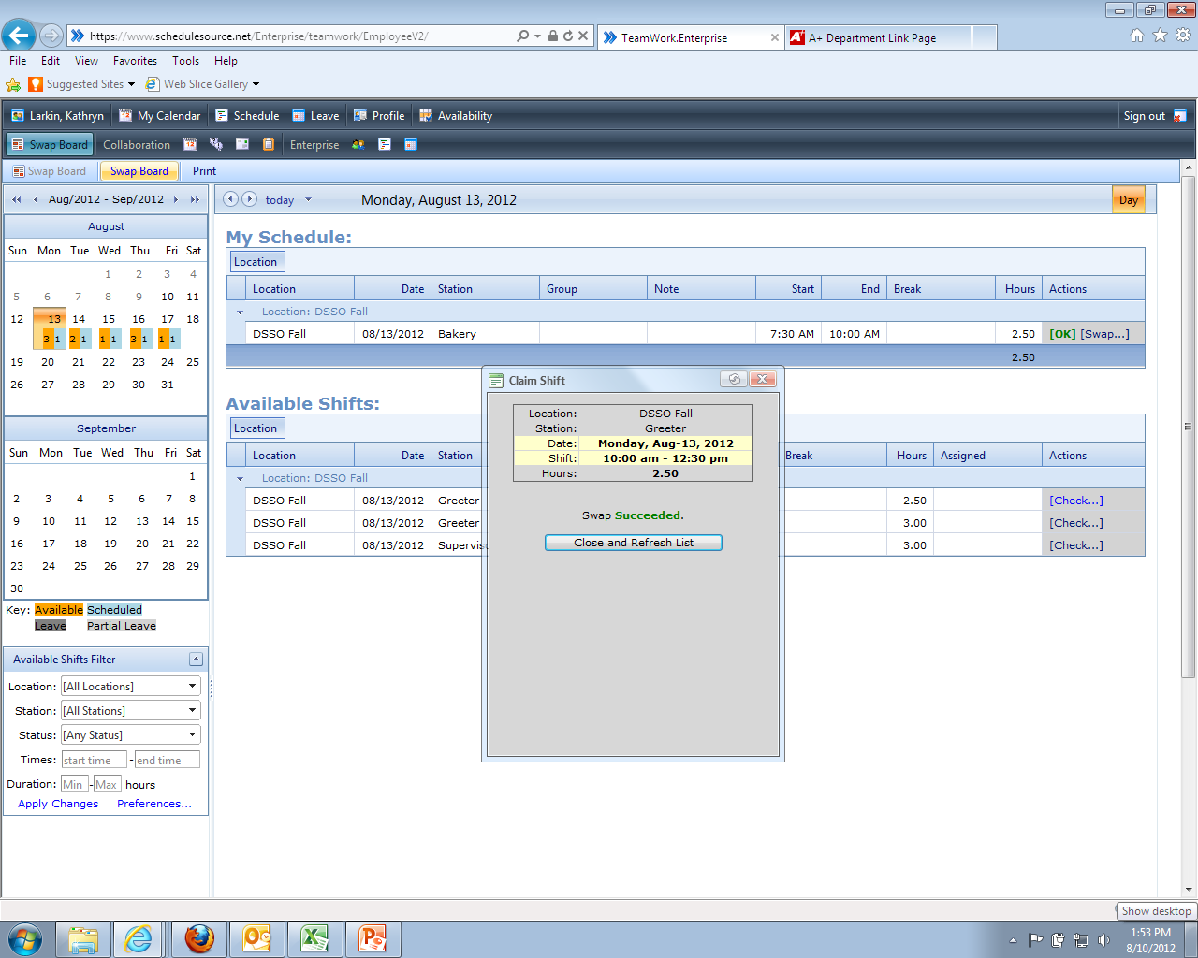
Once you have claimed the shift, the box will refresh and it will say “Swap Succeeded” . The shift is now your responsibility.
To see your shift, you will need to click on the “Close and Refresh List” button.

Slide 22
QUESTIONS??
Please contact the DSSO at 515-294-4864 or email at dssostaff@iastate.edu

